Slide 1
Simulation assignment the UITHOFLIJN
Orestis melkonian
Chris aronis

Slide 2
Problem description
A new tram-line connecting Utrecht with the Utrecht University
Nine stops from Central station to P+R De Uithof
The line operates from 06:00 to 21:30
Two different timetables one for each end station
All trams have a fixed capacity of 420 passengers

Slide 3
Questions to be answered
Feasible frequencies of the tram
Maximum amount of passengers that line can handle
Possible measures to improve the operational performance
SIMULATION

Slide 4
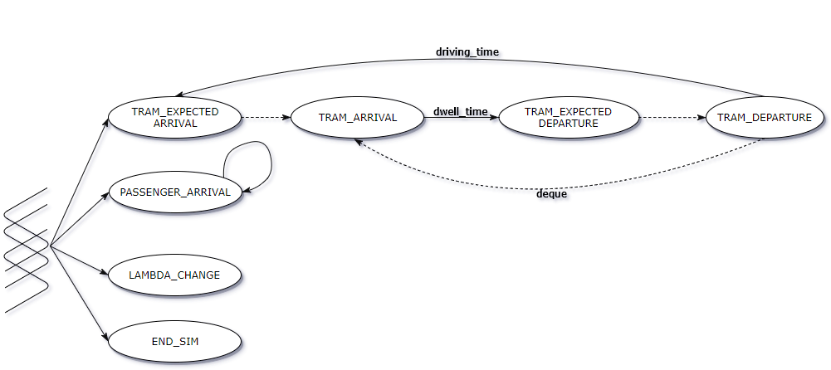
Simulation model

Slide 5
Input analysis

